Slide 1
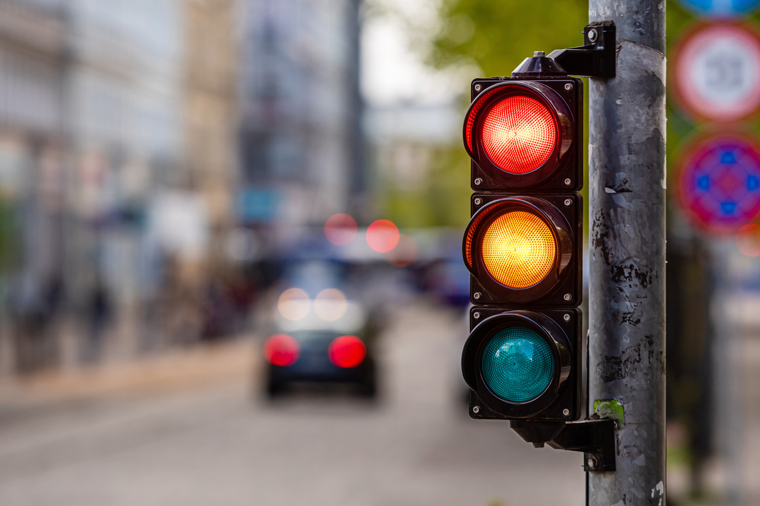
Time Increasing Crosswalk
Lucky 7​
SPIED 2024
Smart Solution for Super Aging Society​
Notes:
SPIED2024
Smart Solution for Super Aging Society

Slide 2
INDEX
01
Intro
02
Pruduct Sketch & Concept
03
WHO? WHAT? WHERE? WHEN? HOW?
04
Differences
Notes:
WHO, WHEN, WHERE, HOW

Slide 3
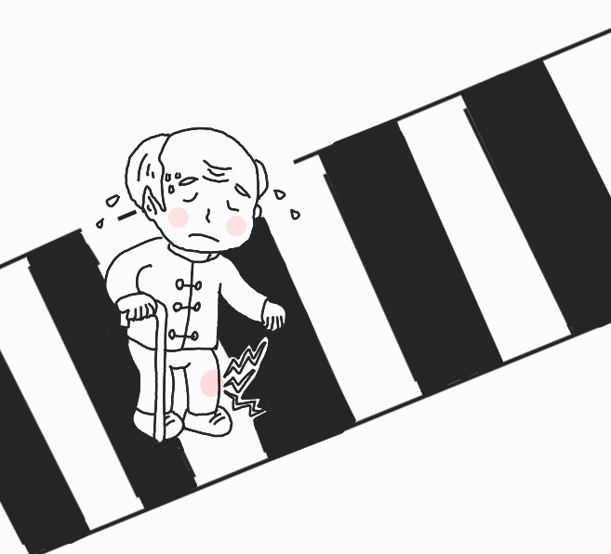
Story 1
The grandfather is crossing the crosswalk.

Slide 4
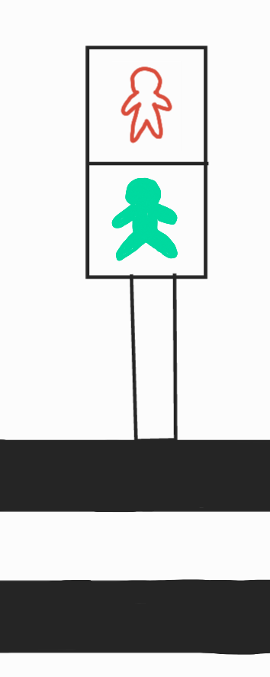
Story 1
The traffic light blinks.

Slide 5
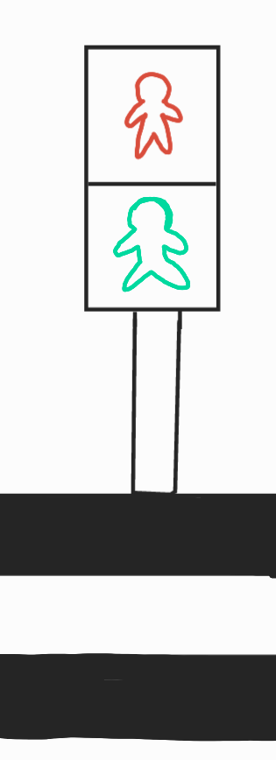
Story 1
The traffic light blinks.

Slide 6
Story 1
The traffic light blinks.

Slide 7
Story 1
The traffic light blinks.

Slide 8
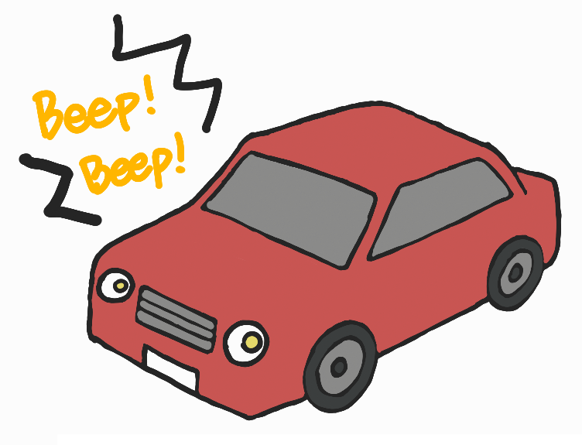
Story 1
A car honks its horn.

Slide 9
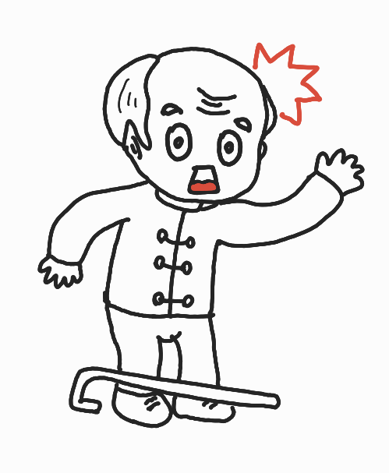
Story 1
He is surprised and afraid.

Slide 10



Story 1
Should he go or go back in this situation?

Slide 11

Story 2
A girl crosses the crosswalk.

Slide 12
Story 1
The traffic light blinks.

Slide 13
Story 1
The traffic light blinks.

Slide 14
Story 1
The traffic light blinks.

Slide 15
Story 1
The traffic light blinks.

Slide 16
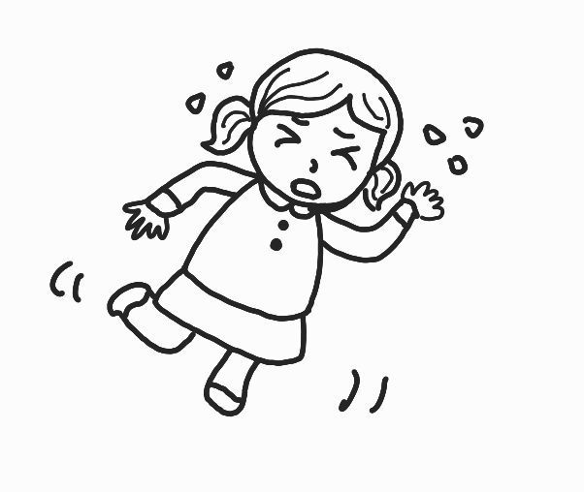
Story 2
She started running very fast.

Slide 17
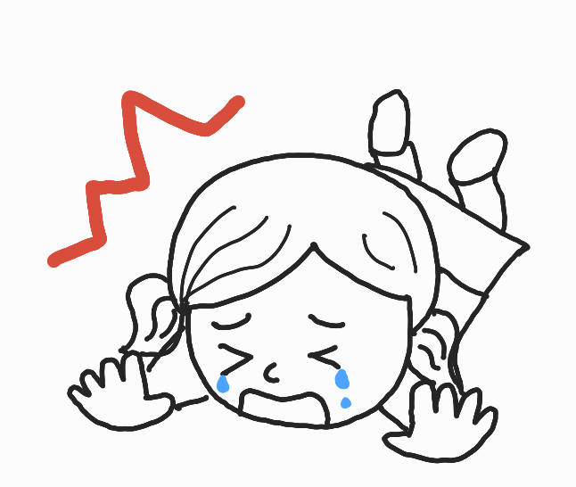
Story 2
She fell at the crosswalk.

Slide 18



Story 2
In this situation,
Should she cross the crosswalk or not?

Slide 19

Time
Increasing
Crosswalk

Slide 20
If there are no people with limited mobility,
the same time
If there are people with limited mobility,
the time gets longer

Slide 21
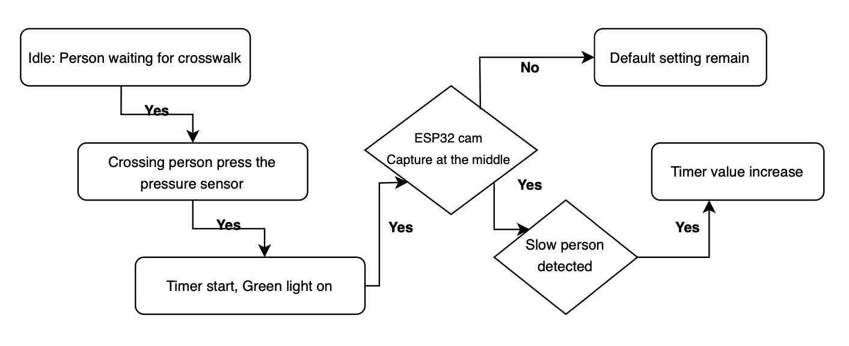
Flowchart

Slide 22
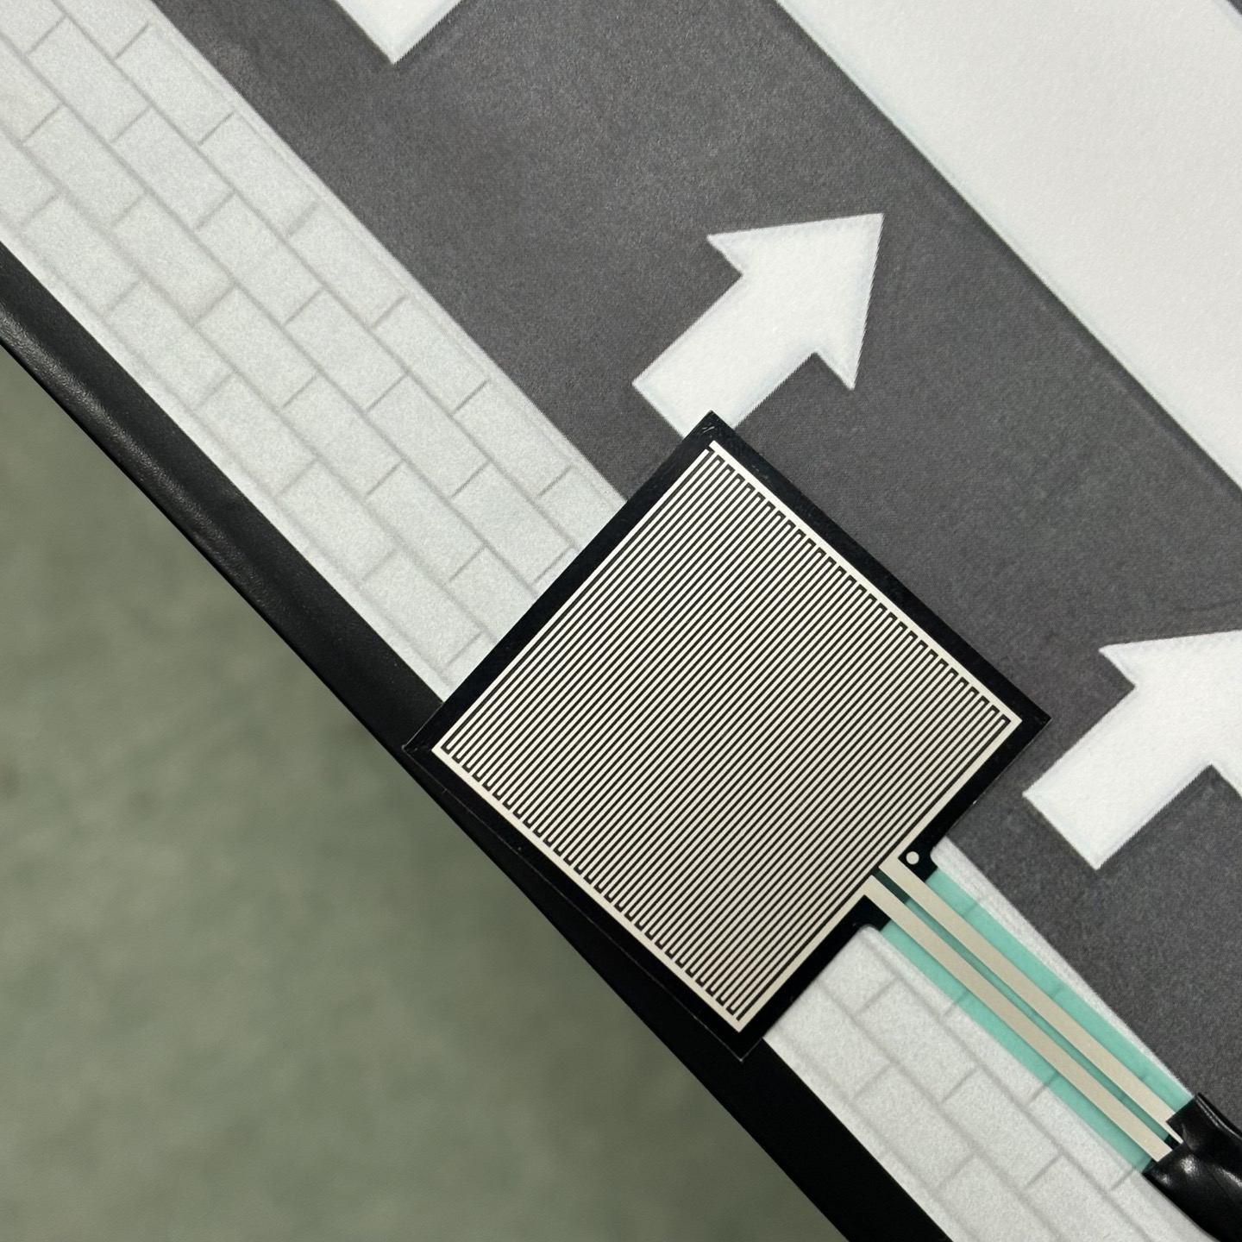
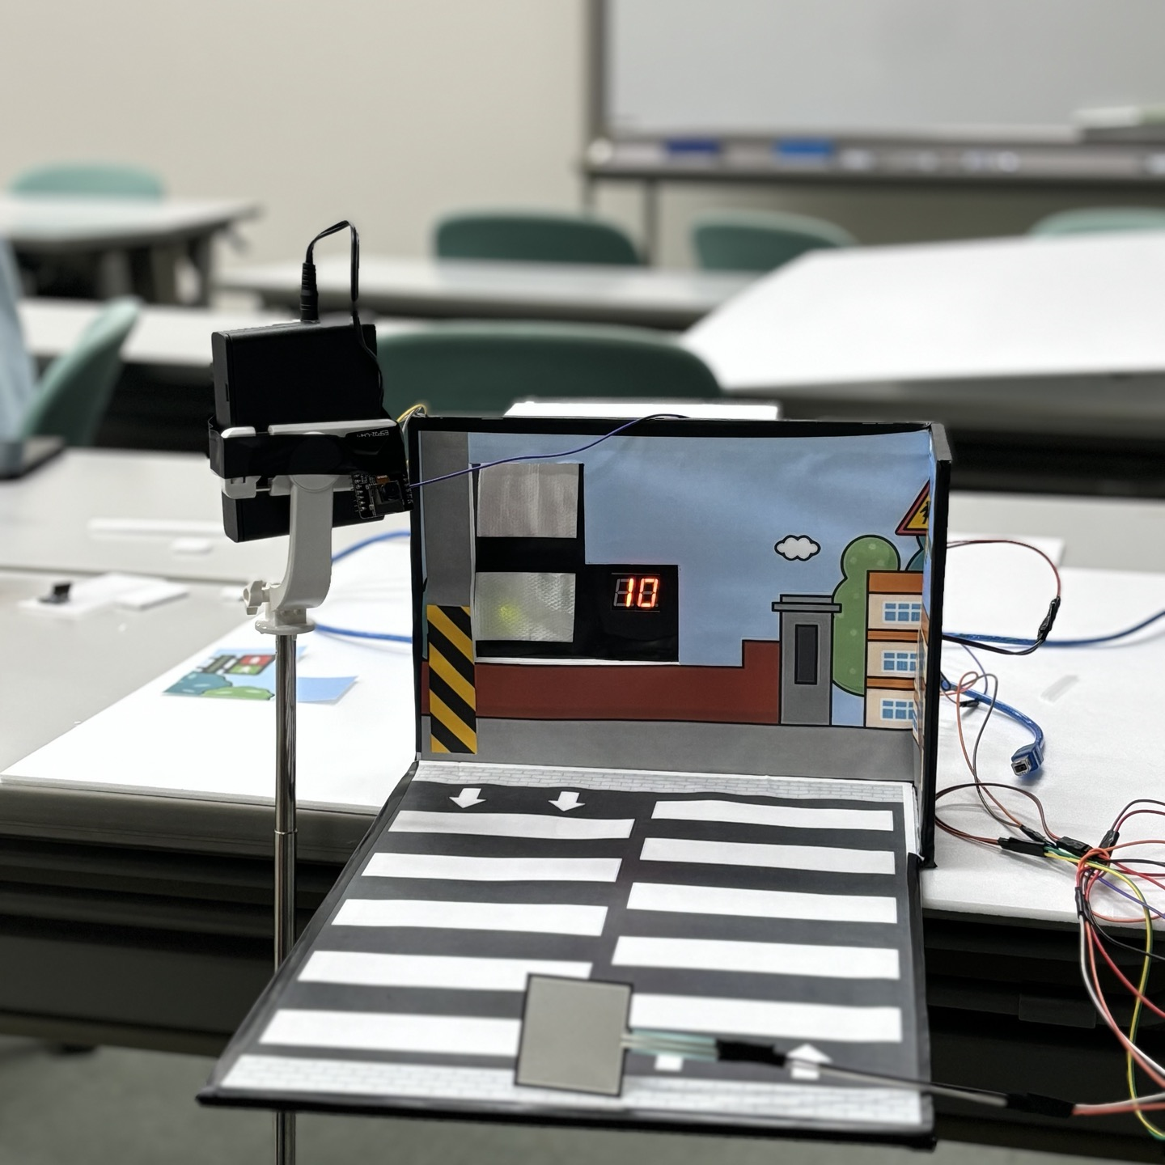
Our Product
pressure sensor
When a person waits in front of a crosswalk,
After a few seconds,
the traffic light turns green.

Slide 23
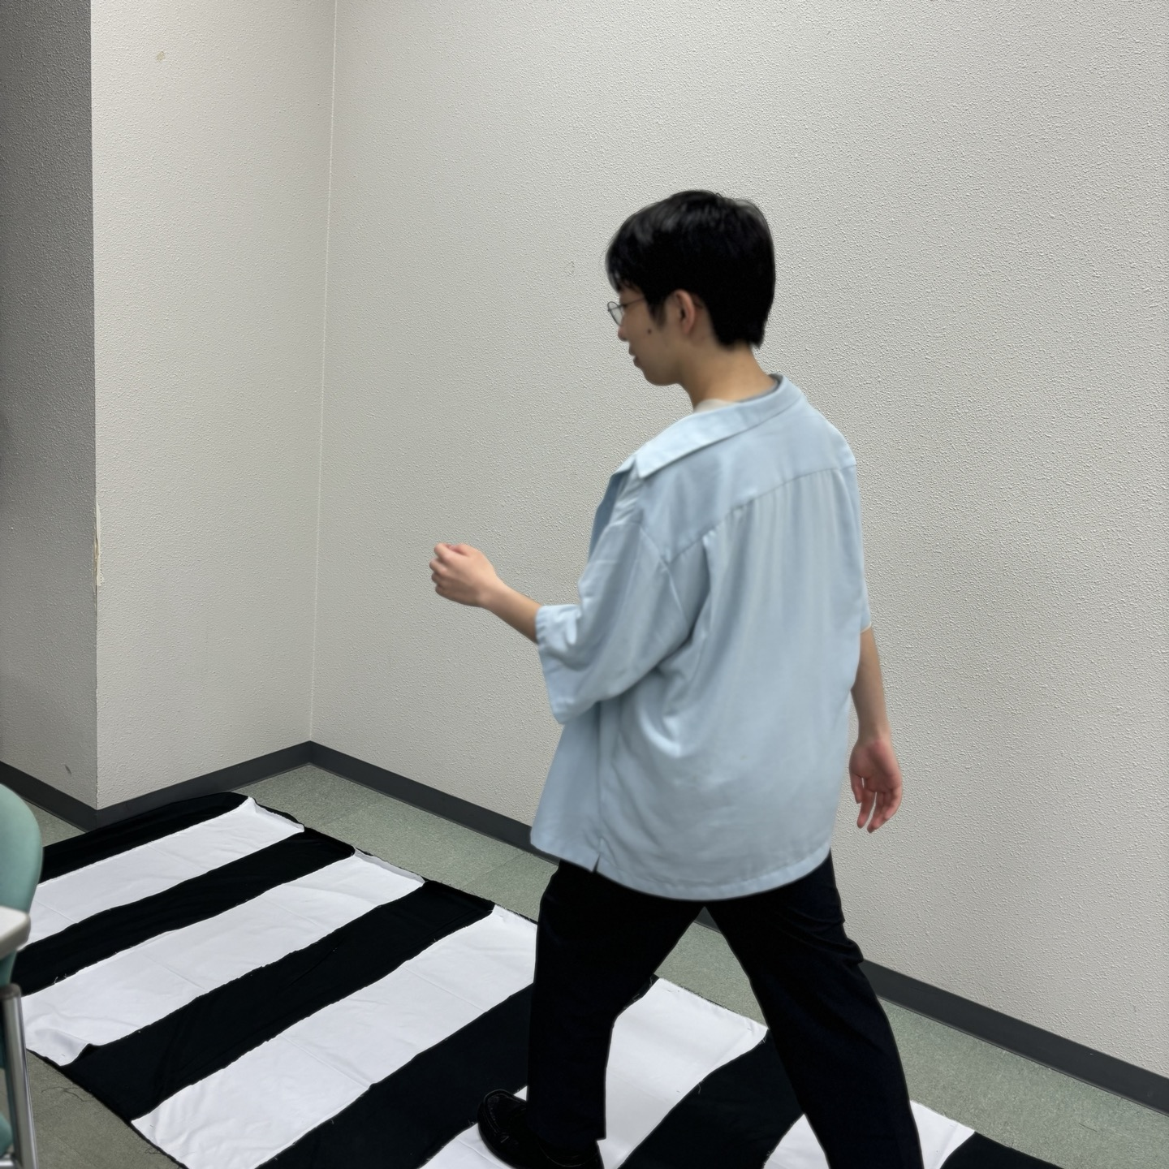
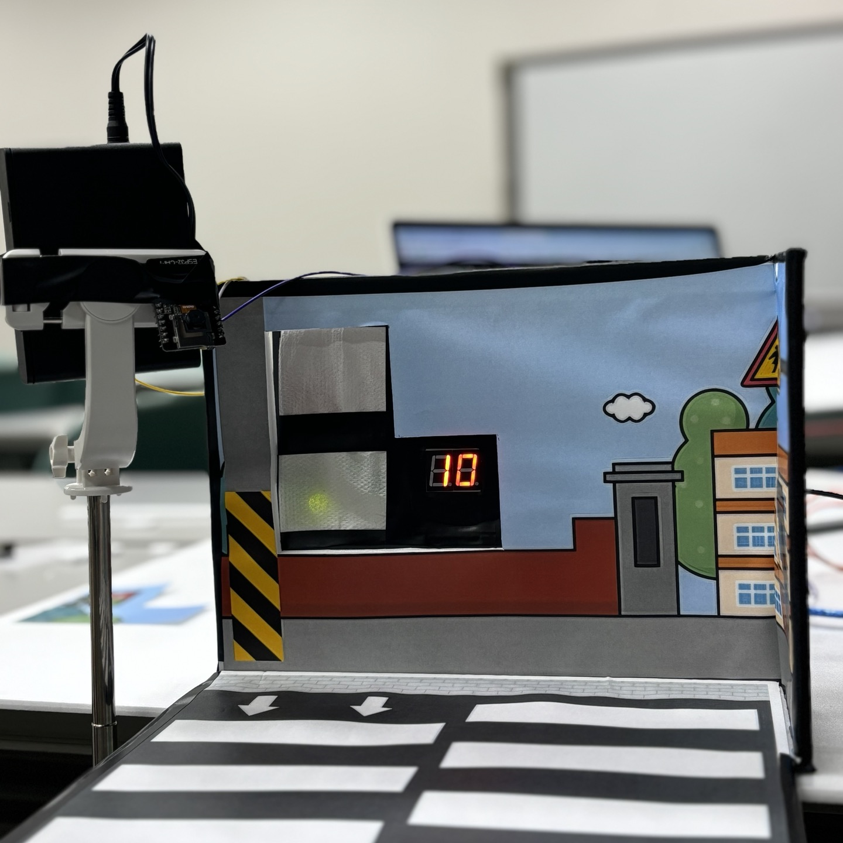
Our Product
No one has limited mobility.
The timing of the traffic lights is the same.

Slide 24
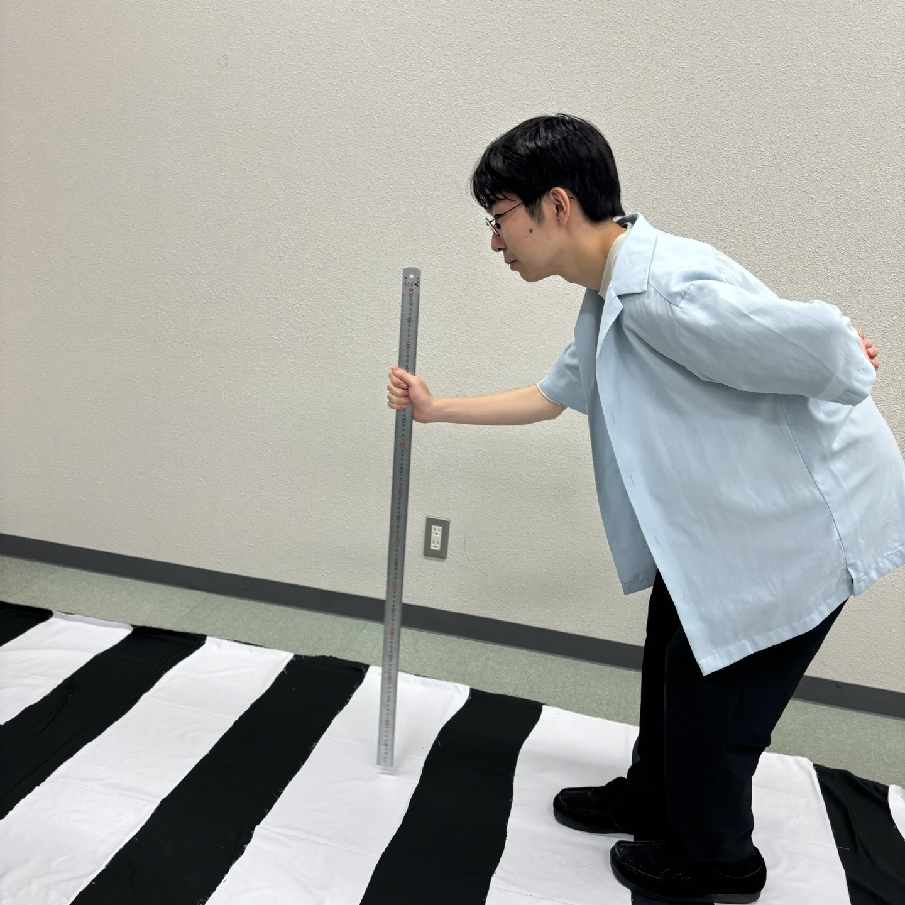
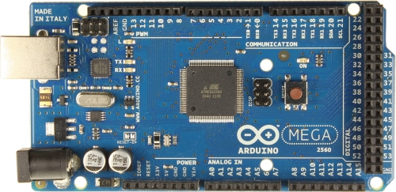
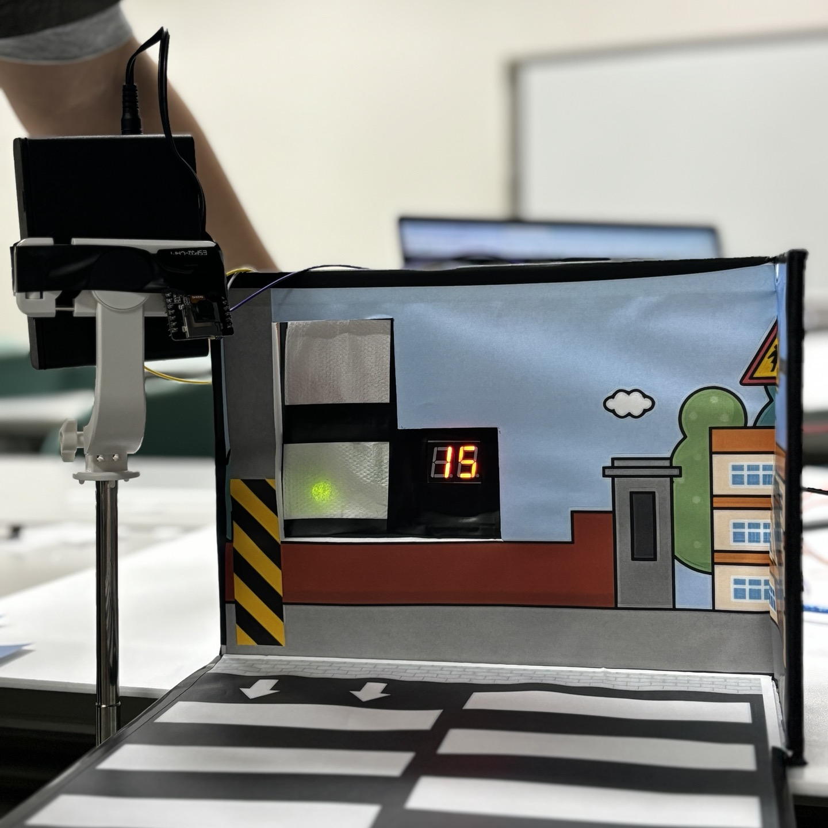
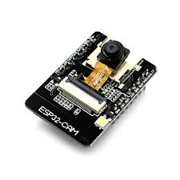
Arduino receives a signal.
People
with limited mobility
ESP32-CAM
The traffic light time is increased.
If there is a person with 5 seconds left at the traffic light,
the camera recognizes the person.

Slide 25

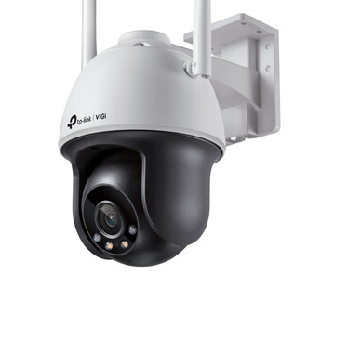
ESP32-CAM
Wireless CCTV
It is also safe for the elderly and from crime.

Slide 26

Who & what
1. Elderly
2. Children
3. People with limited mobility
They can cross traffic lights more safely.

Slide 27
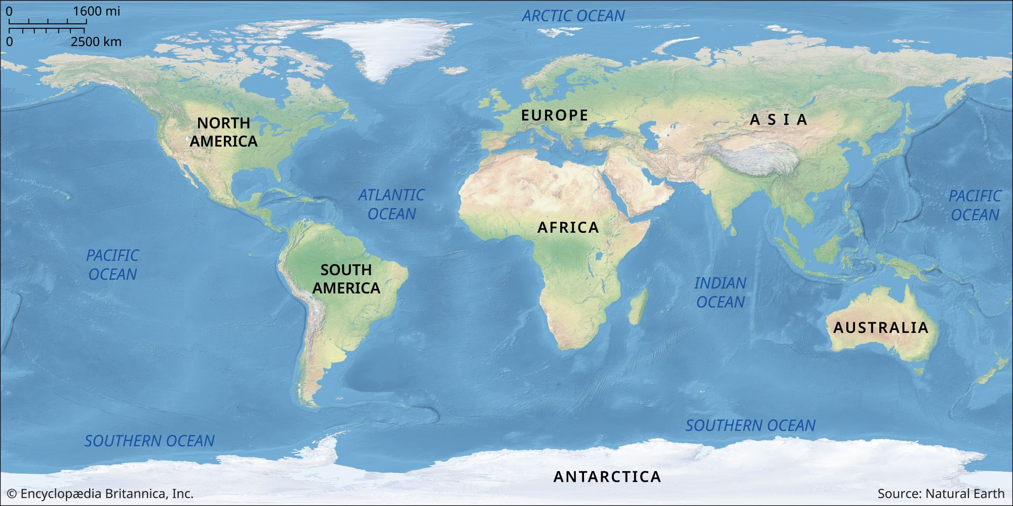


Where
Easily accessible from simple crosswalks in various areas.
When
It can be used both day and night.
It is available 24 hours a day.

Slide 28
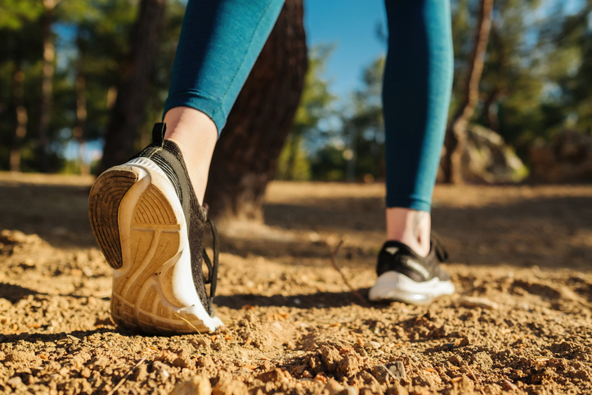
how
Very easy to use
Simply cross the crosswalk. You see your progress immediately.

Slide 29
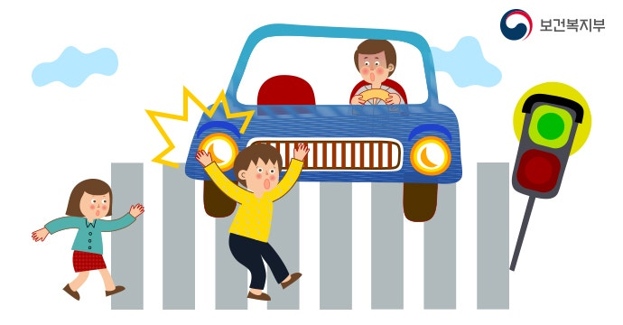
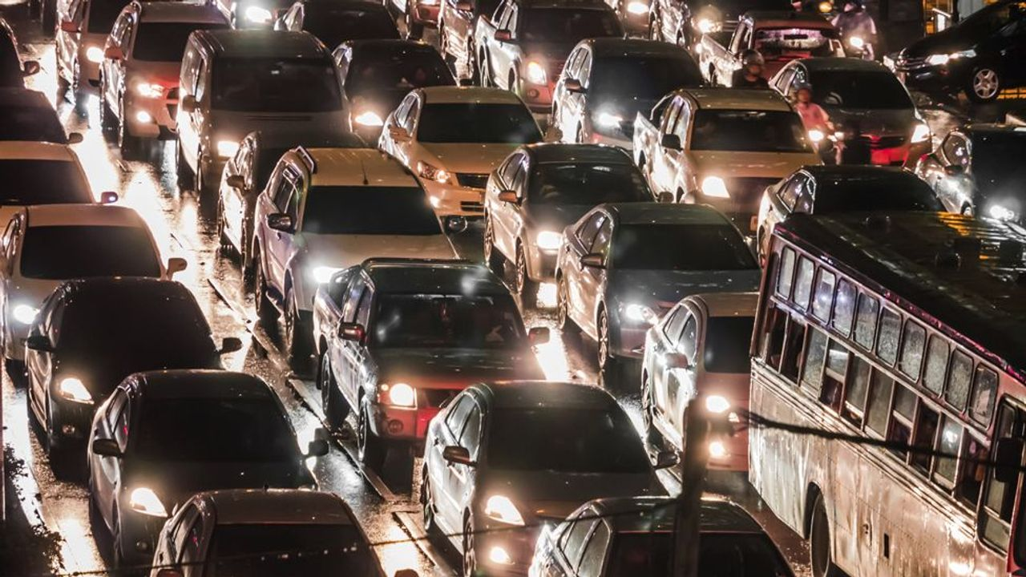
Expected Effect
You can cross the crosswalk safely.
Accidents can be reduced.
Traffic congestion can be reduced.

Slide 30
Self Assessment
Strengths
Weaknesses
Operated fully automatically.
Smart functions can be improved.
Encounter unexpected situations.
Be able to confuse people.
Opportunities
Threats
Improvise with a strong wireless connection.
Heavy SW service with a server.
Traffic jams in area.
In case of a large amount of local traffic.

Slide 31
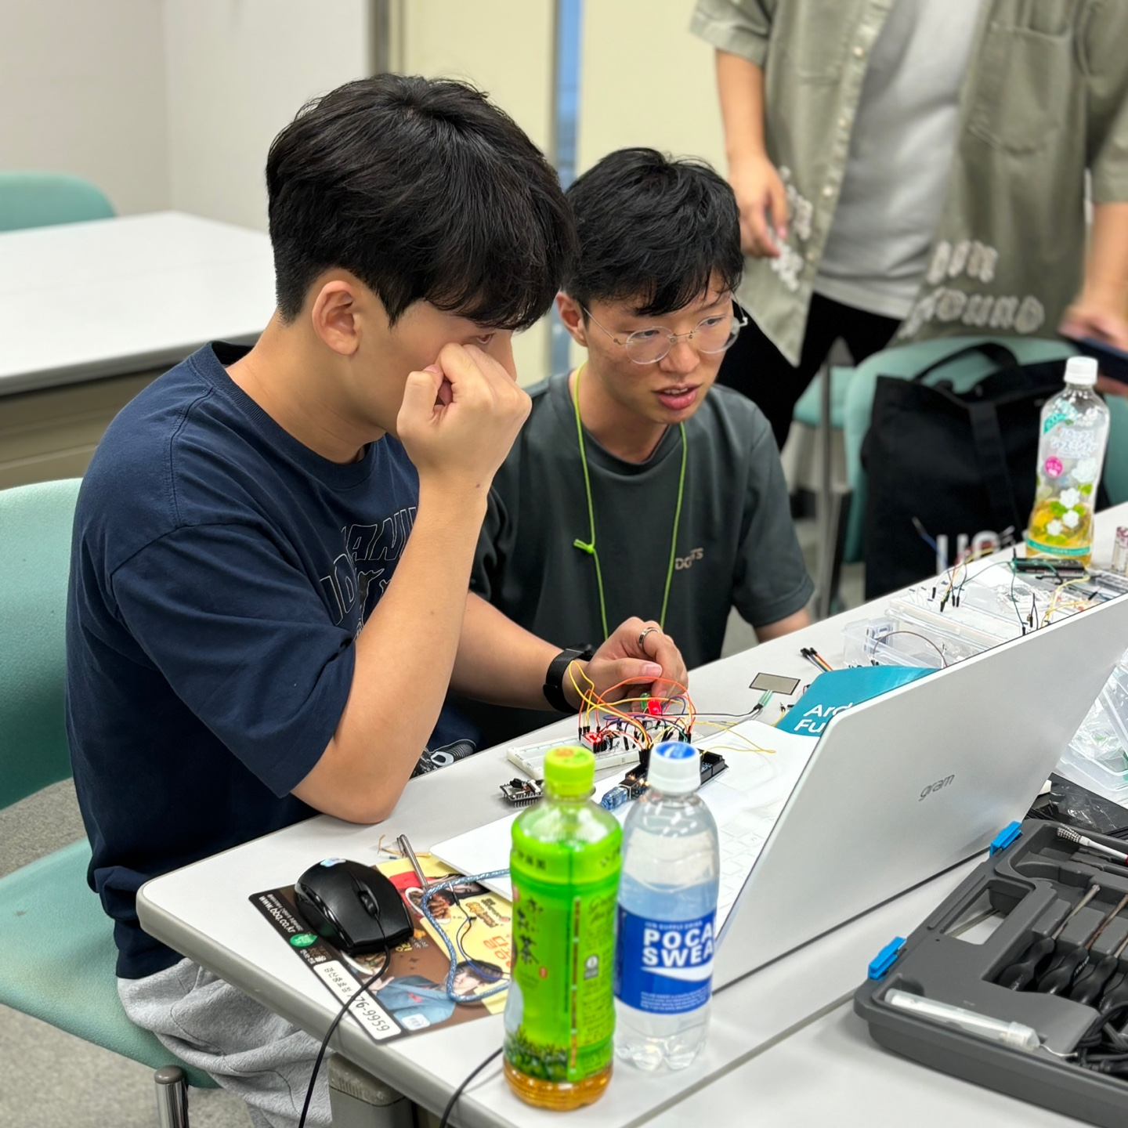
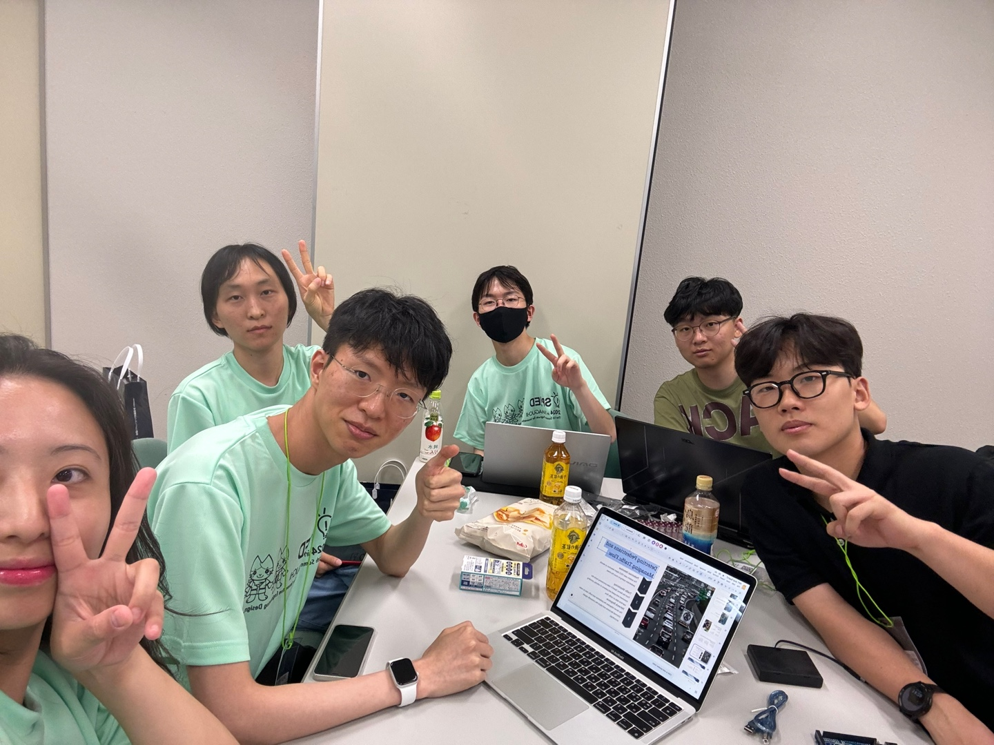
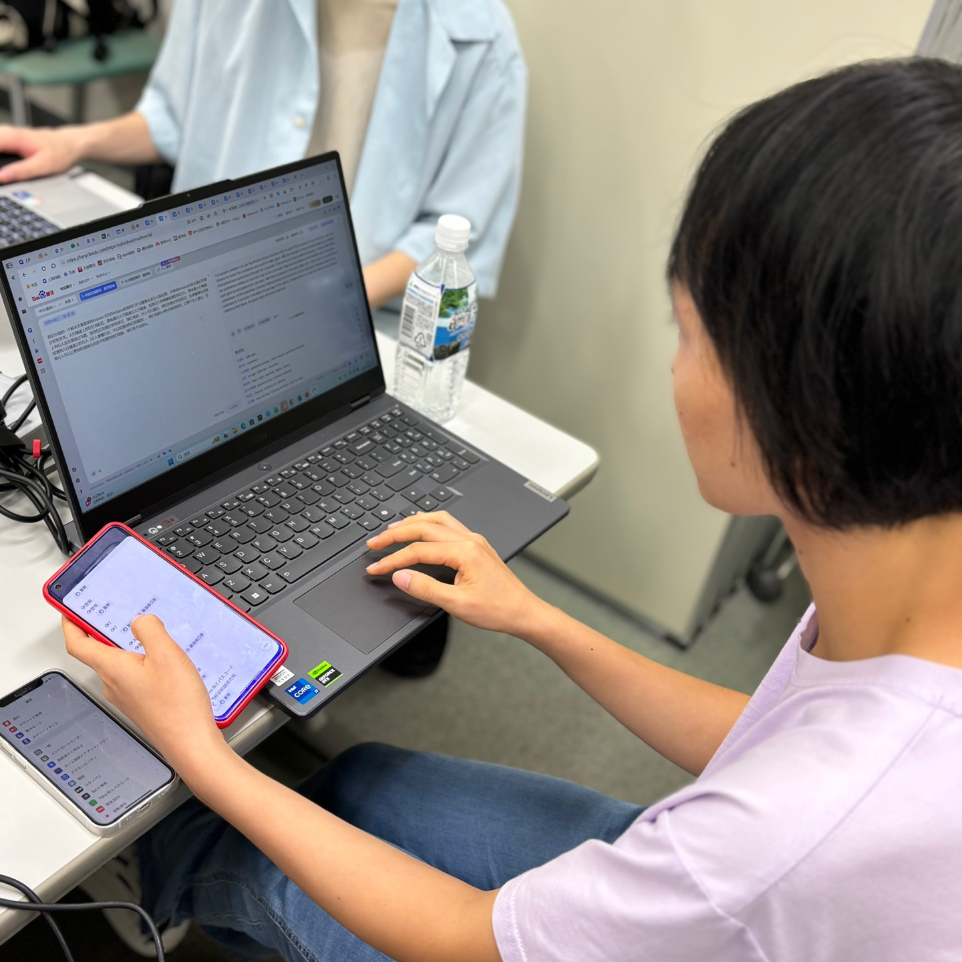
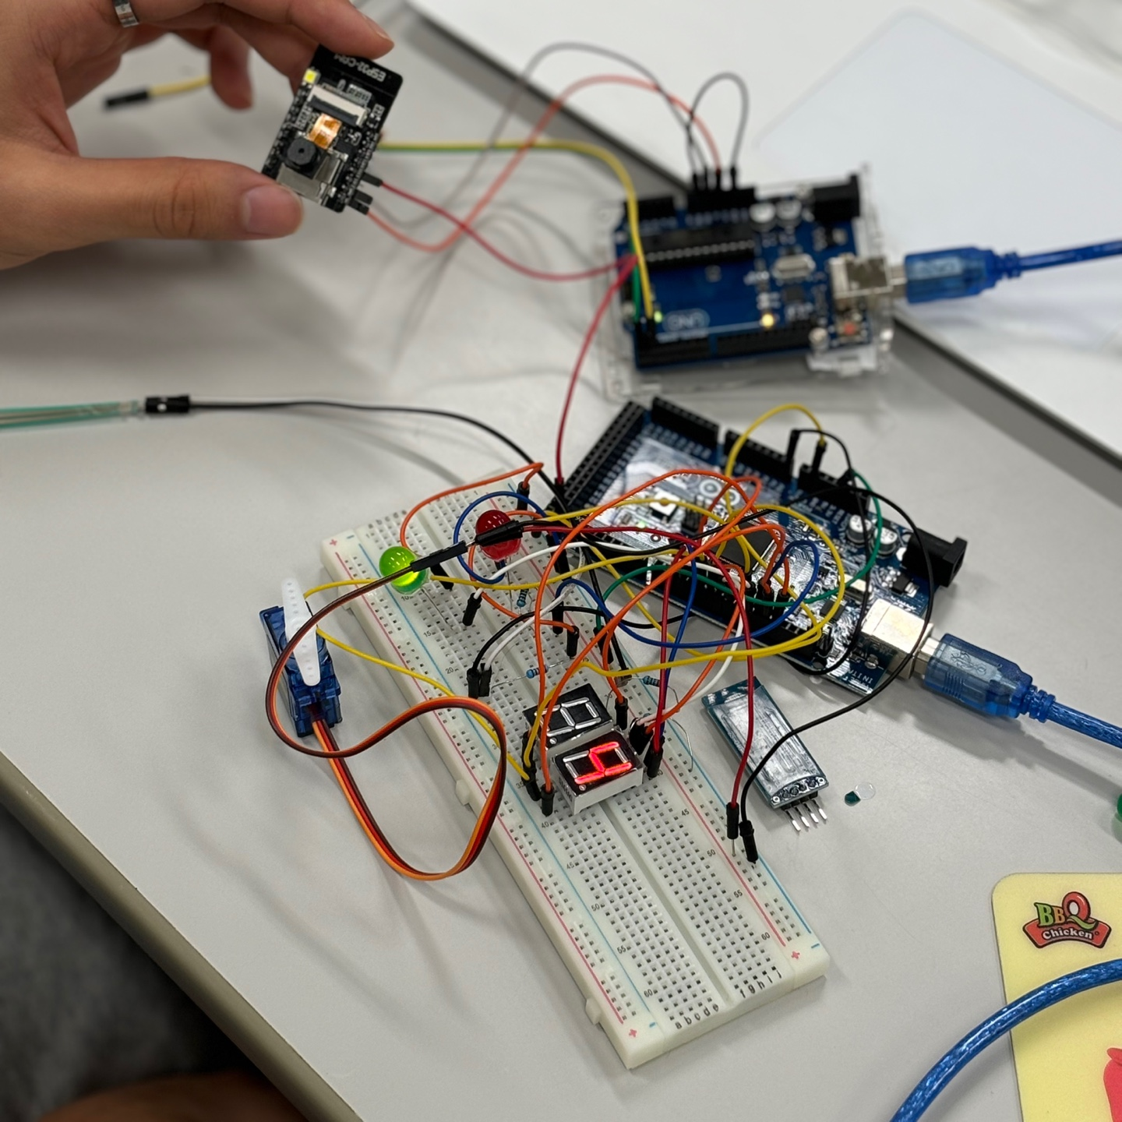
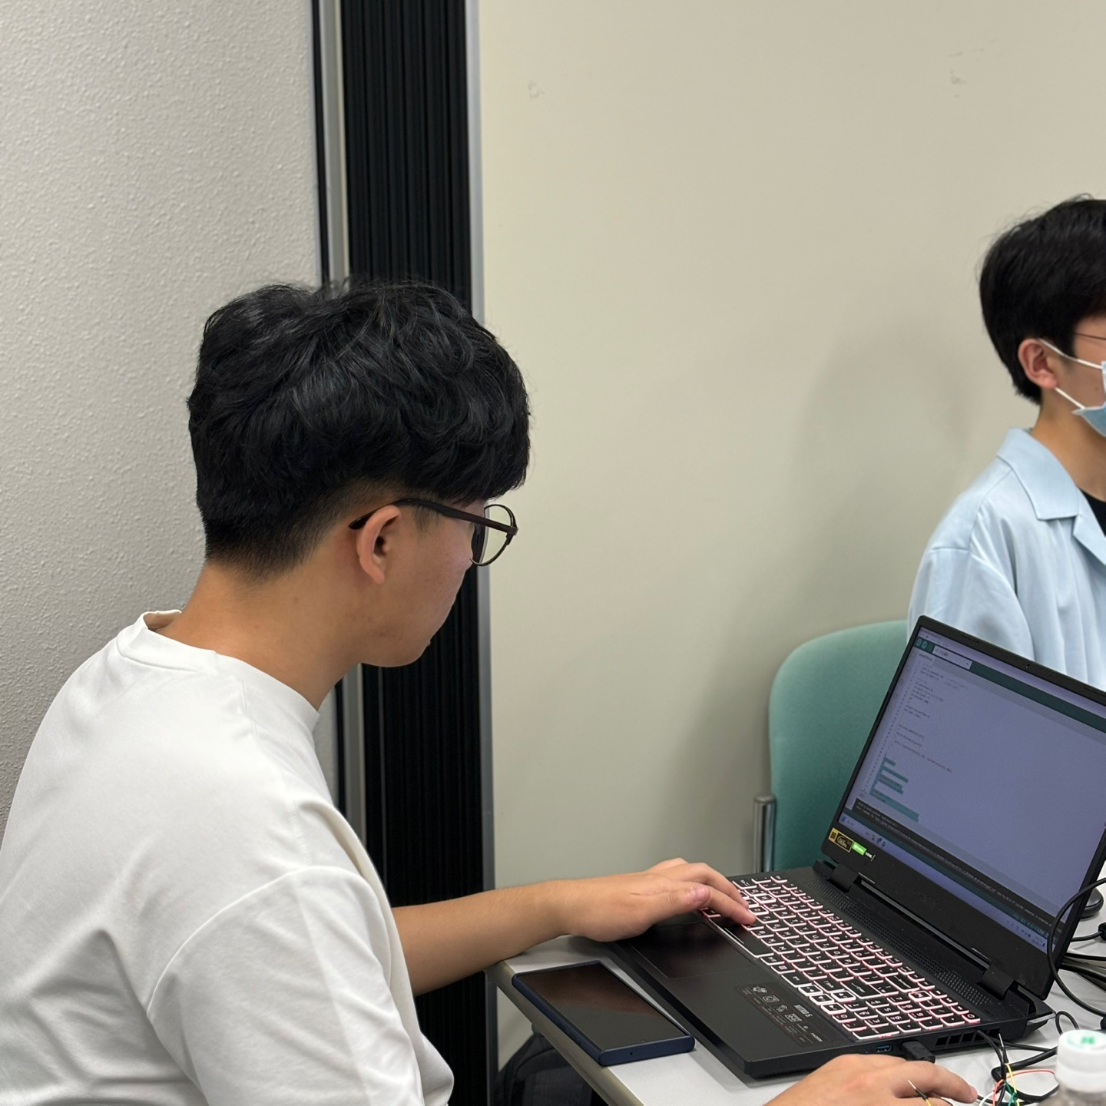
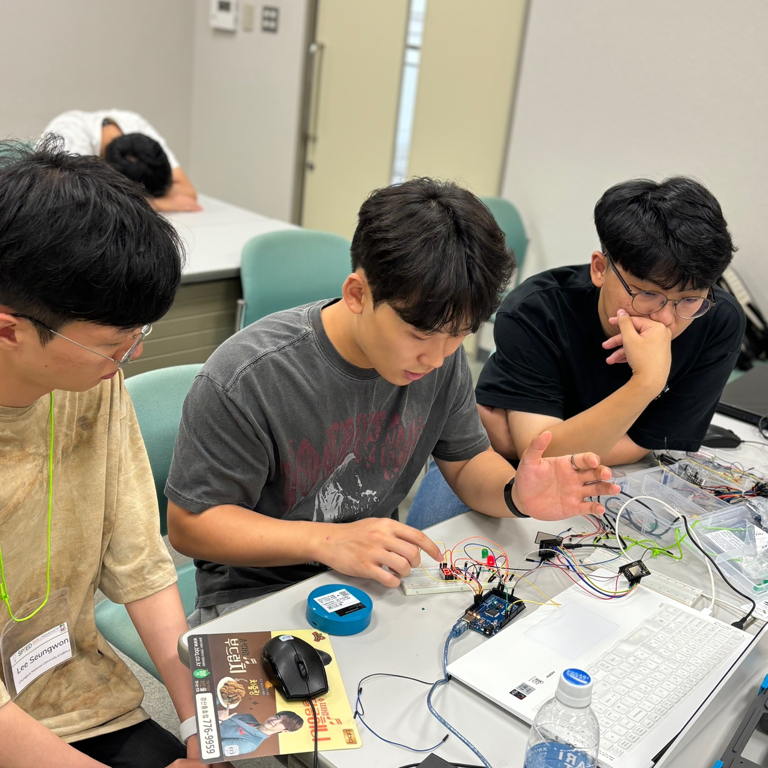
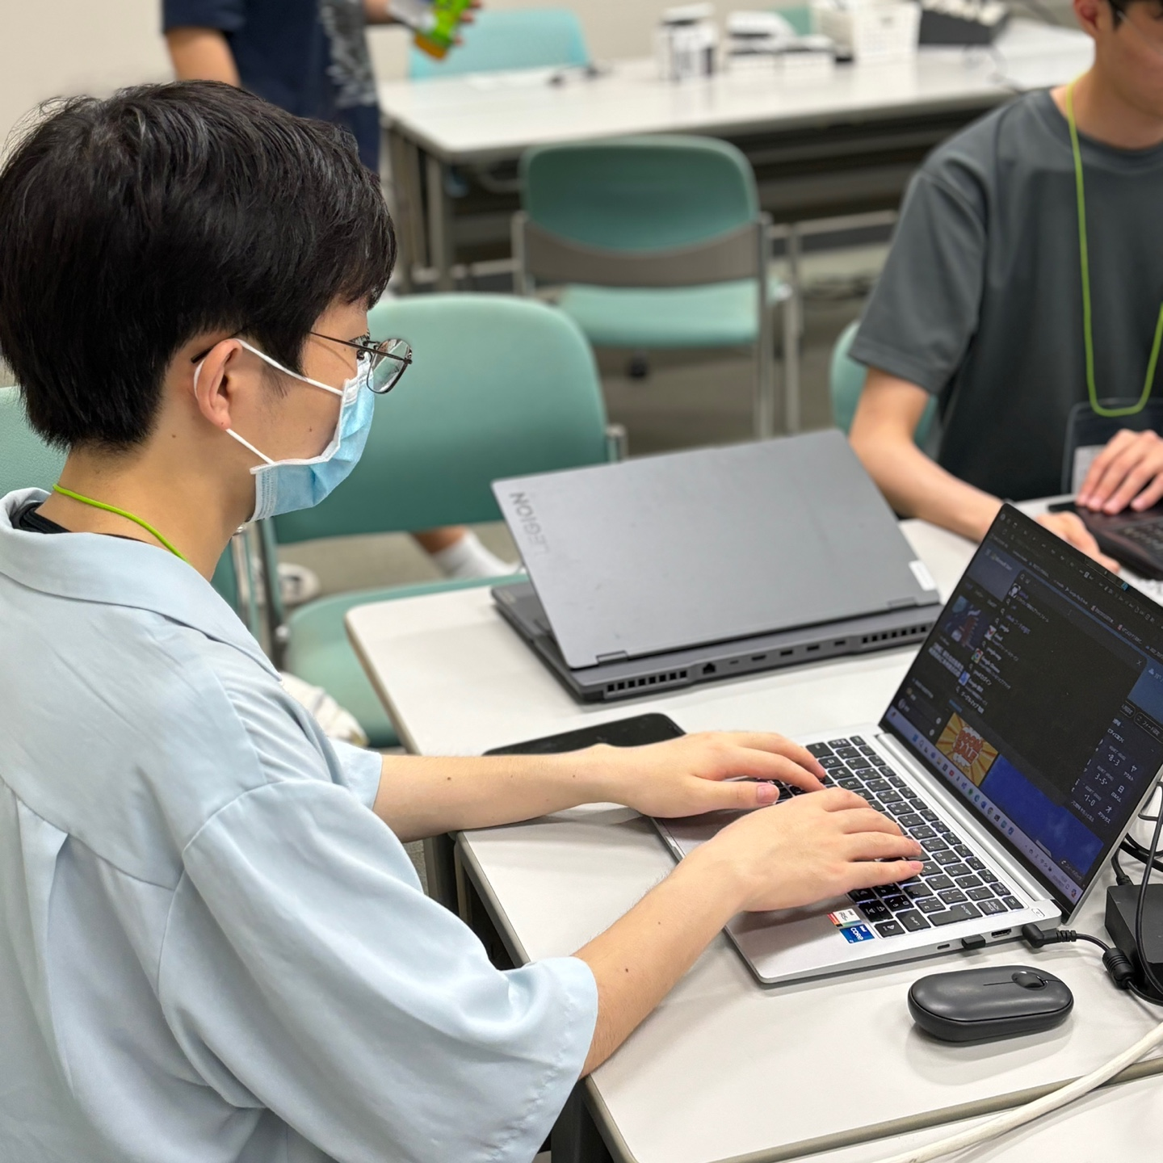

tHANK YOU

Slide 32
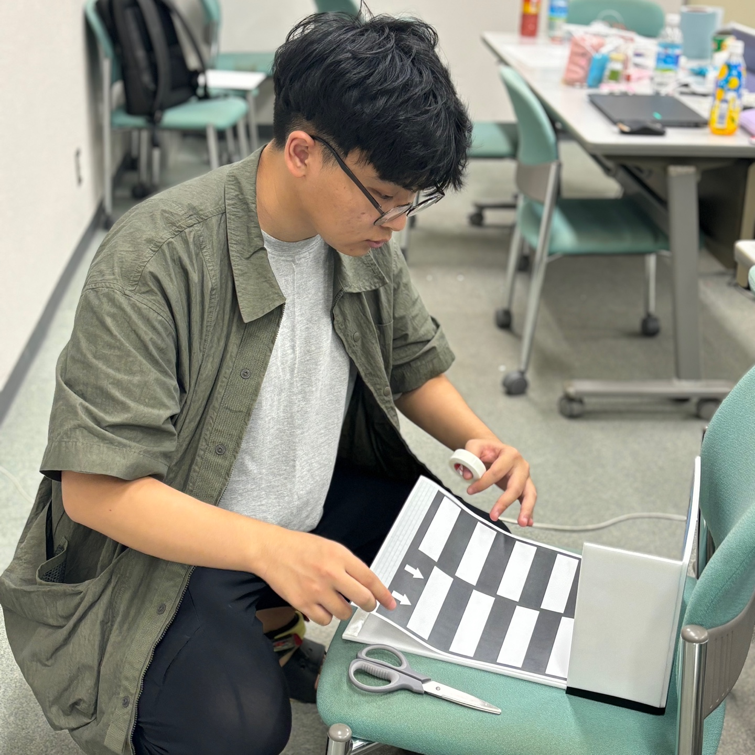
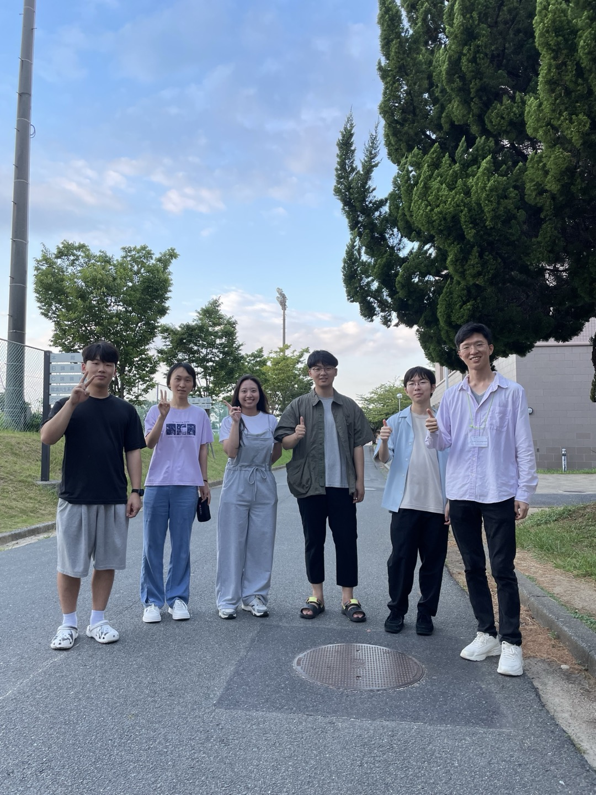
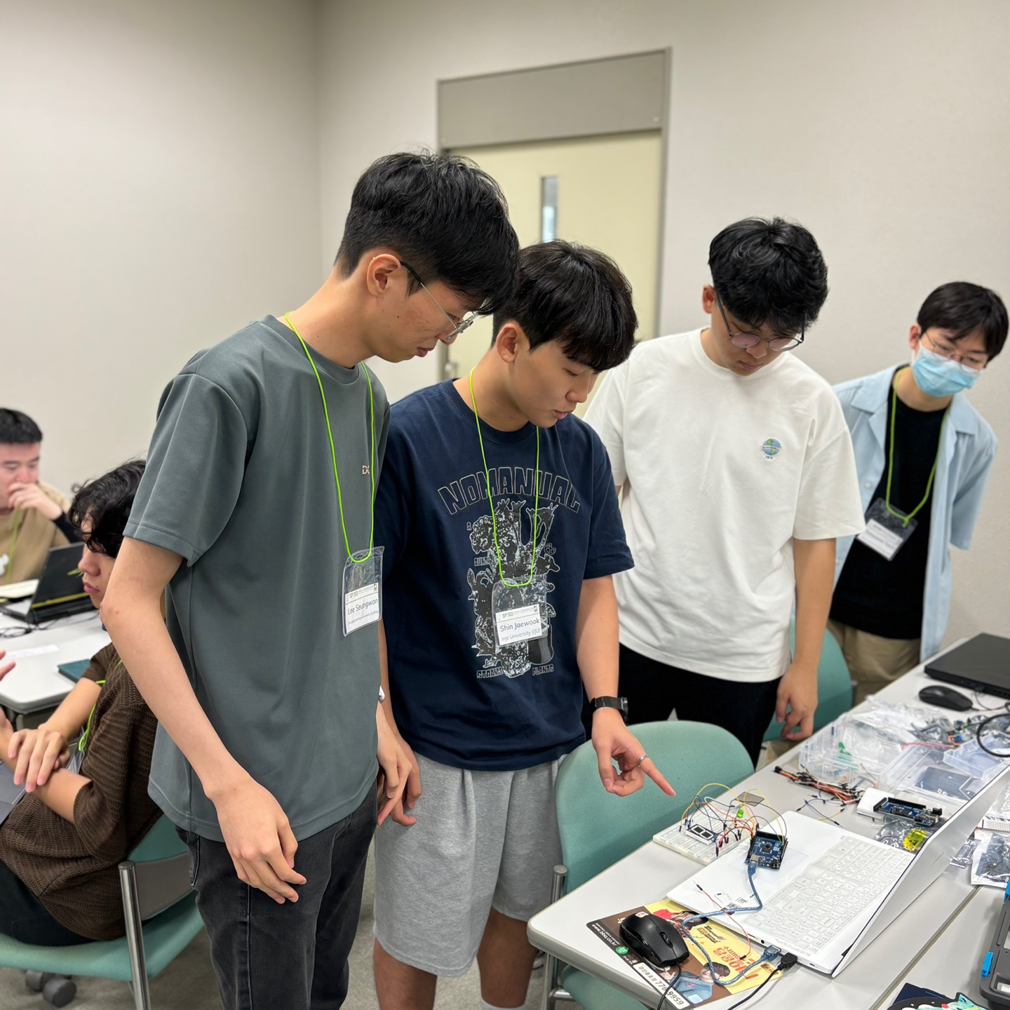
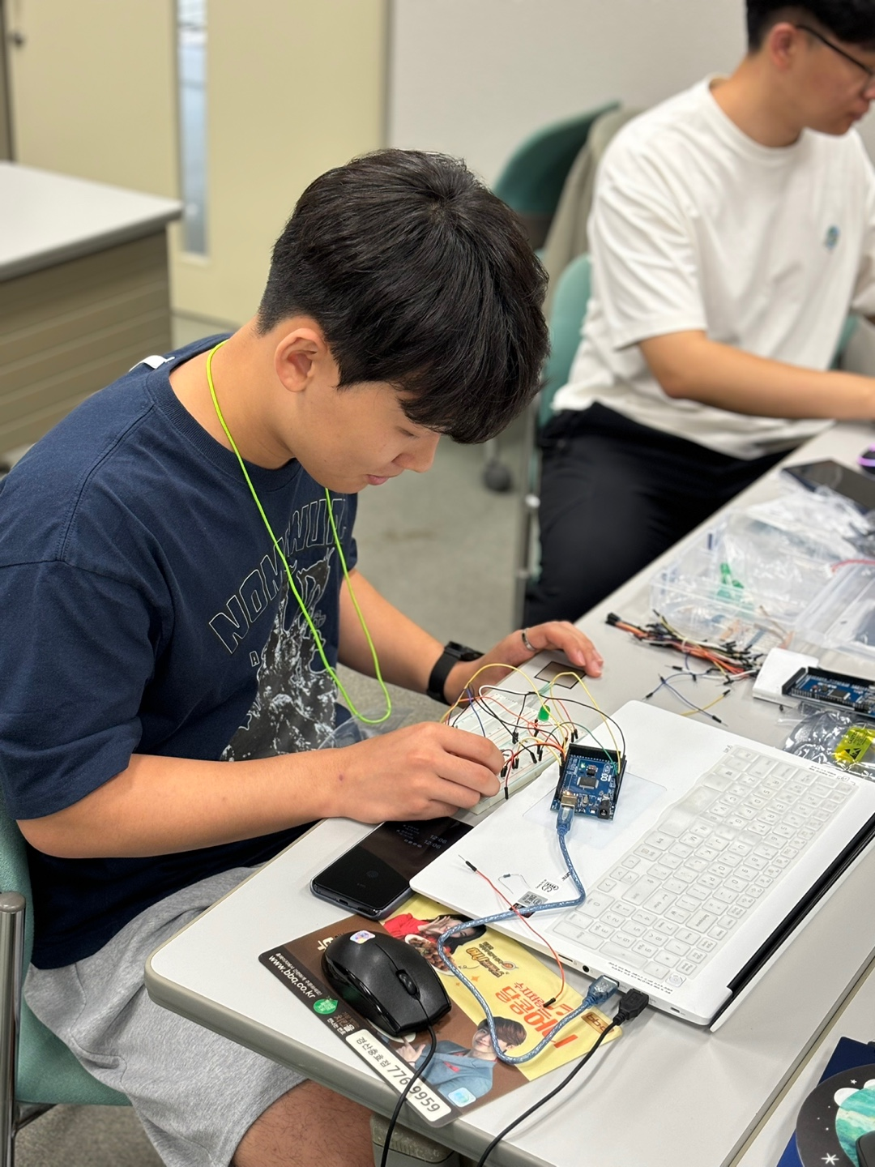
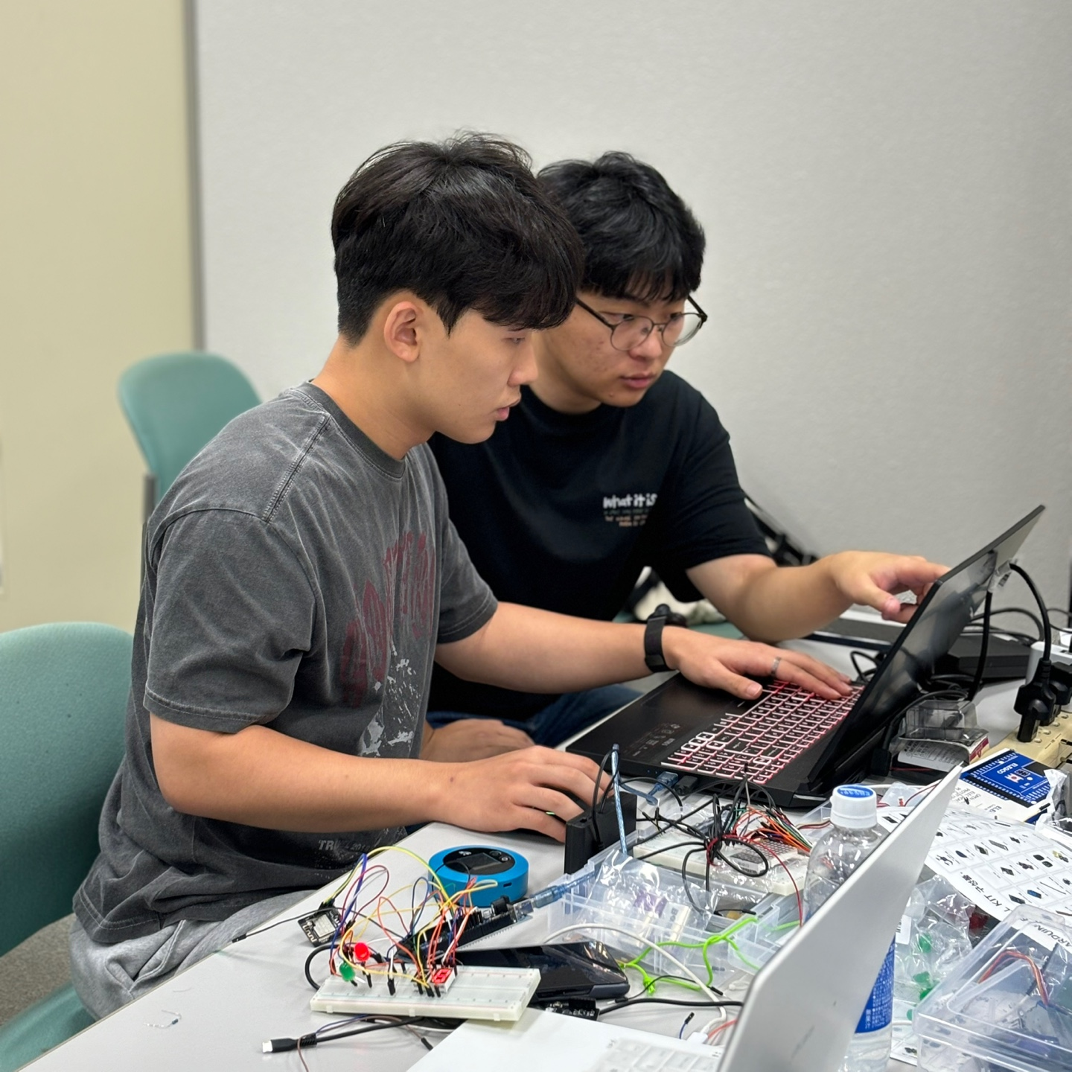
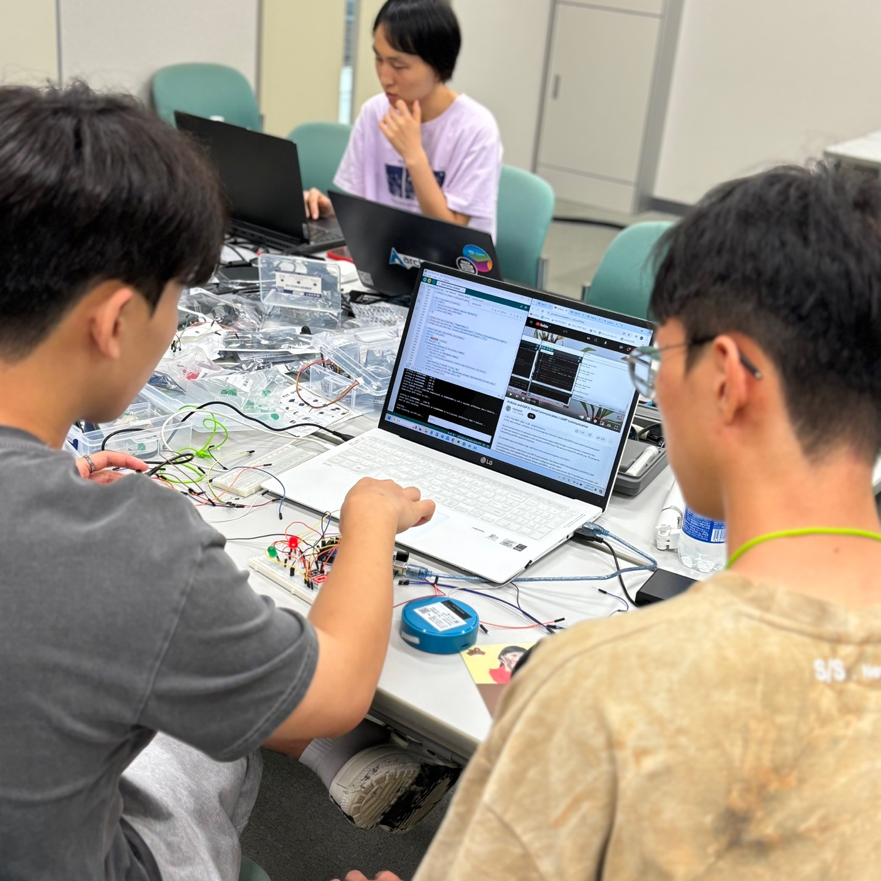
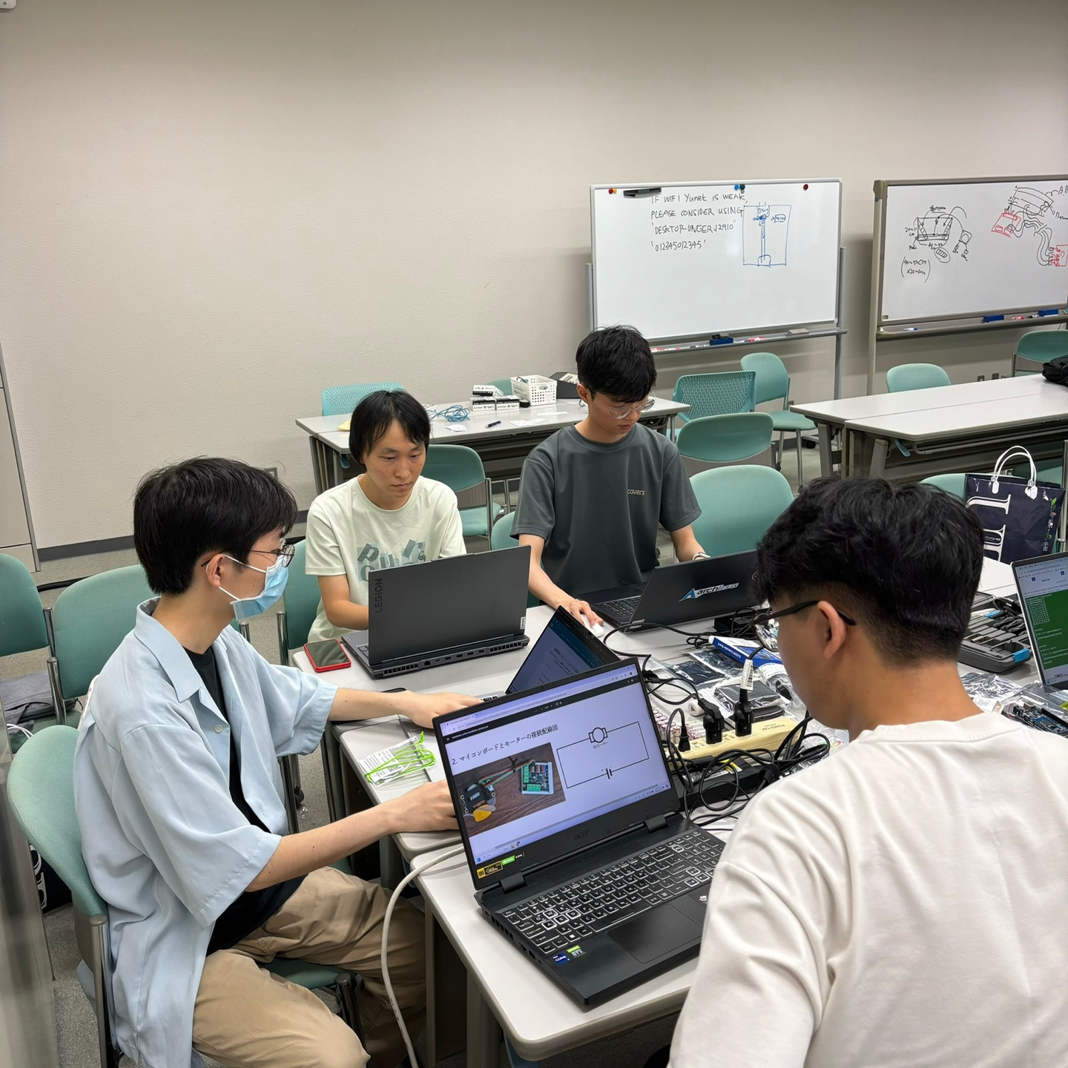
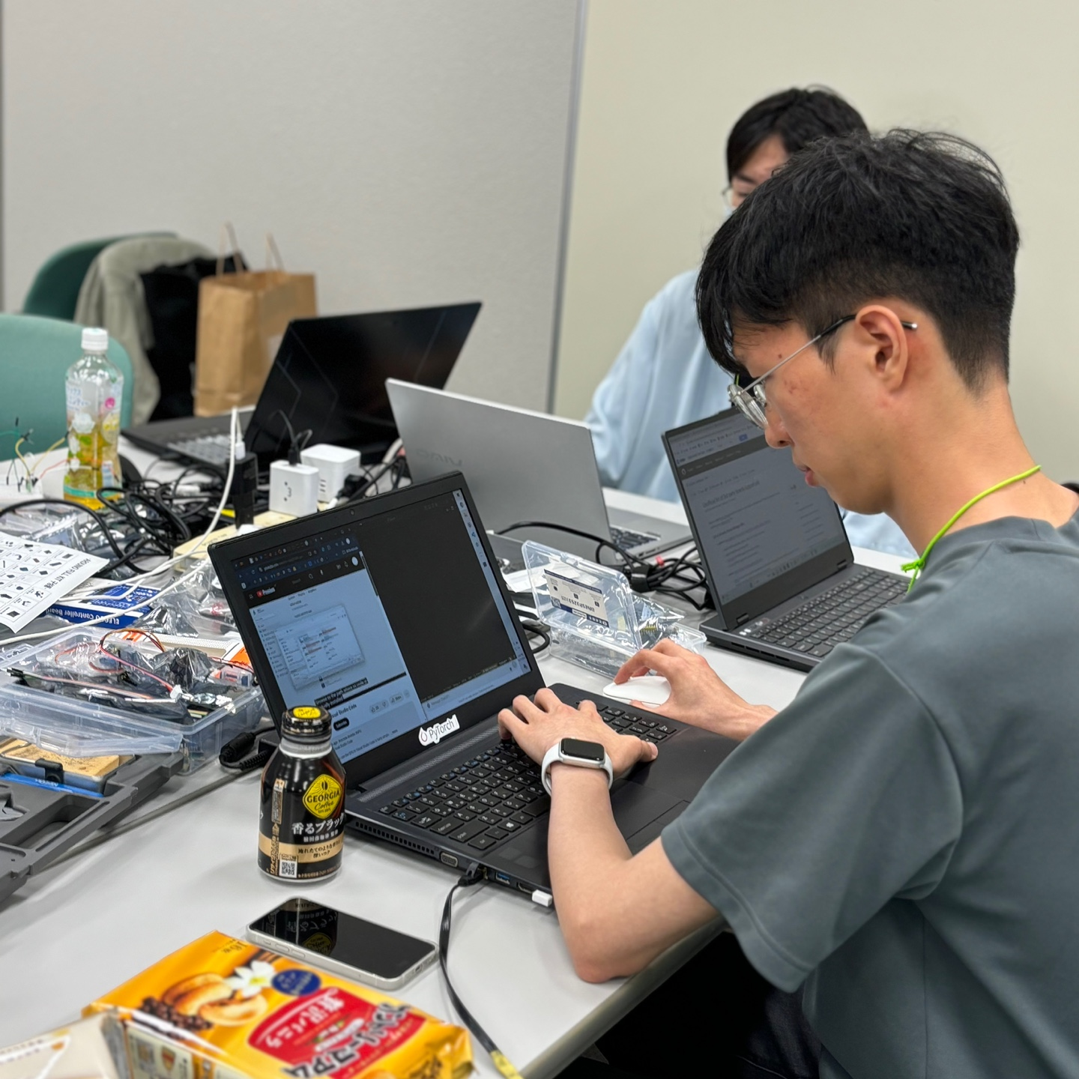
Q & A

